Slide 1

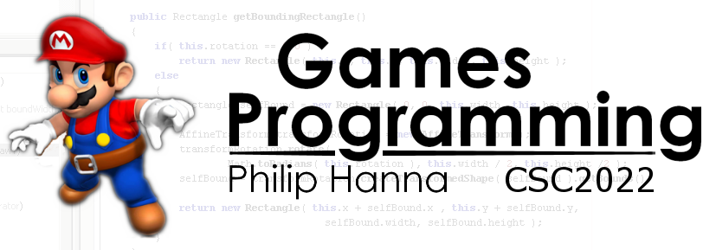
UX Design
Designing with the user’s experience in mind.
Part 3 - Reading

Slide 2

Reading is Unnatural

Slide 3
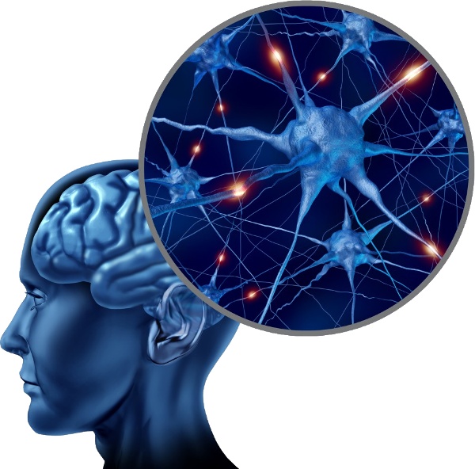
We’re ‘wired’ with an innate ability to develop speech and understand spoken language. We’re not wired to read.
Reading and writing (which have only become common in recent centuries) are leant through instruction and repeated practice.
Reading normally requires some degree of conscious attention and effort.

Slide 4

We don’t read websites. We scan them.

Slide 5
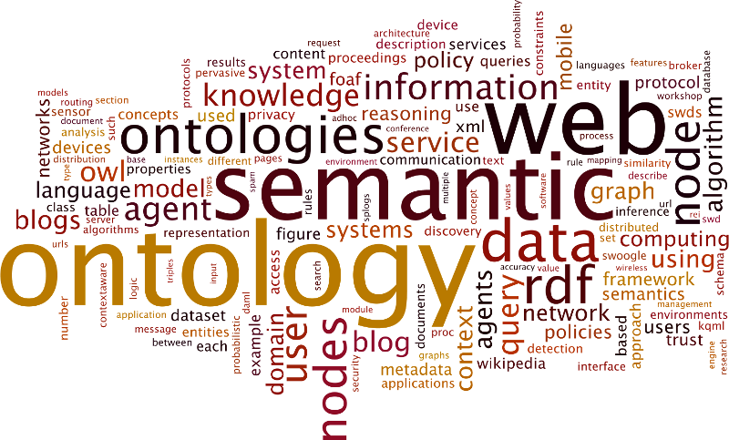
We tend to scan information looking for words or phrases that catch our eye.
We do this as:
We know we don’t need to read everything;
We don’t want to waste time and effort.
Aside: The obvious exceptions to the above are pages that contain documents, e.g. reports, new stories, descriptions, etc.

Slide 6
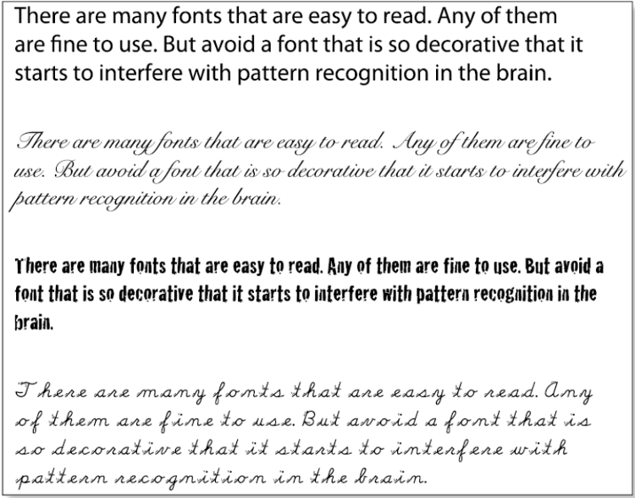
Difficult typefaces
Reading is made more difficult if the font hinders the brain in grouping letter shapes into word chunks.

Slide 7
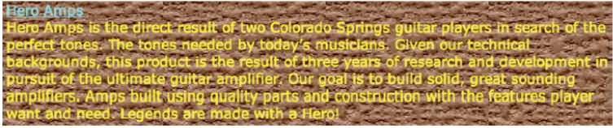
Noisy Backgrounds
Visual ‘noisy’ can make the recognition of letter shapes and words more difficult.
There should be good contrast between displayed text and the background.

Slide 8
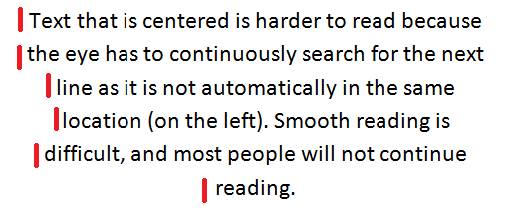
Centered Text
At the end of a line our eyes will flick back to the same horizontal position and down one line.
Text that is centered or right-aligned will tend to disrupt this process and reading more effortful.

Slide 9

To make reading as effortless as possible:
Use an easily readable font. This includes many decorative fonts that can be easily read.
Use a clear and consistent text layout.
Use plain language (or at least a highly consistent vocabulary).

Slide 10

Omit needless words. A sentence should contain no unnecessary words, a paragraph no unnecessary sentences.
Get rid of ‘happy talk’. Avoid welcoming users or providing informational overviews.
Minimise instructions. Everything should be self-explanatory. If really needed, be brief and to the point.

Slide 11

Key takeaways:
Reading requires effort (and we want to make life easy for the user).
We should ensure that all text can be easily read.
We should ensure that all text conveys genuinely useful information (ruthlessly removing any text that does not ).

